Slide 1
Cookbook for Practice 7.2
实践7.2攻略
Cong Li 李聪

Slide 2
Configuration in GPU Kernel
GPU Kernel中的配置
Create a new file ‘kernel.c’
创建一个新文件’kernel.c’
Dimension of the feature array
特征数组长度
Training data tile size
训练数据分块大小
Thread group size
线程分组大小

Slide 3
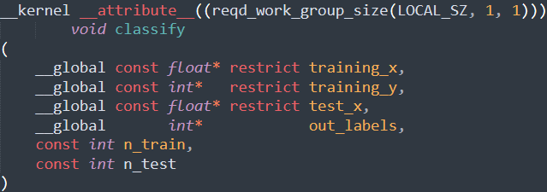
Kernel w/ Group Size
Kernel的分组大小
Define a new function
定义一个新的函数
Thead group size
线程分组大小

Slide 4
Kernel w/ Group Size
Kernel的分组大小
Define a new function
定义一个新的函数
Input parameters. Again, 2D arrays flattened to 1D arrays
输入参数，2维数组再度平铺为1维数组

Slide 5

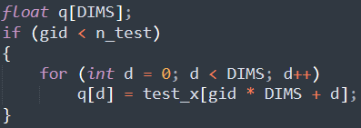
Getting Test Data in Place
让测试数据就位
Get the global thread ID, & the local ID within a group
获取全局线程ID和组内线程ID
Each thread processing one test data element;
we read it into a local array
每个线程处理一个测试数据，所以我们读入一个局部数组

Slide 6

Start of the Classification
开始分类
Initialize the nearest neighbor information
初始化最近邻信息
Initialize the program-controlled cache
to store a training data tile
初始化被程序控制的缓存，存储一个训练数据分块
Start the loop over the training data tiles
开始循环遍历训练数据分块

Slide 7
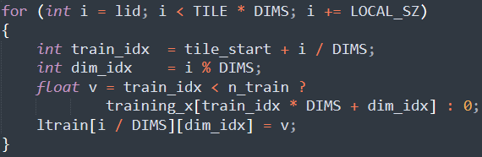
Collaborative Load 协同读取
Threads in a group cooperatively load the training data tile
组内各线程协同读取训练数据分块的一部分
Avoid out-of-boundary access
防止越界读取

Slide 8
Collaborative Load 协同读取
Threads in a group cooperatively load the training data tile
组内各线程协同读取训练数据分块的一部分
Threads in a group synchronize for load completion
组内各线程同步，确保读取完成

Slide 9
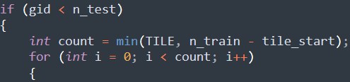
Compute for the Tile
为当前分块计算 (1)
Get the exact tile size & loop over the training data
获取分块大小并循环遍历训练数据
Avoid out-of-boundary access
防止越界读取

Slide 10
Compute for the Tile
为当前分块计算 (1)
Get the exact tile size & loop over the training data
获取分块大小并循环遍历训练数据
Avoid out-of-boundary access
防止越界读取

Slide 11
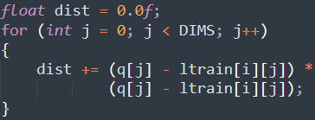
Compute for the Tile
为当前分块计算 (1)
Get the exact tile size & loop over the training data
获取分块大小并循环遍历训练数据
Compute the distance
计算距离

Slide 12
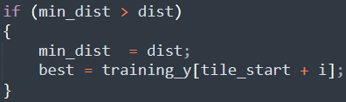

Compute for the Tile
为当前分块计算 (2)
Compare distance & update nearest neighbor information
比较距离并更新最近邻信息
Close the inner loop & ‘if’ branch, & synchronize the threads in a group for completion of using the training data tile
结束内重循环和’if’条件分支，
组内各线程同步，确保使用训练数据分块都已完成

Slide 13
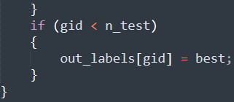
Finish the Kernel
结束这个Kernel
Close the outer loop & write out the classification result
结束外重循环，写回分类结果
Avoid out-of-boundary access
防止越界读取

Slide 14

Basic Settings 基本设置 (1)
Create a new file ‘gpu.py’ & import relevant libraries
创建新文件’gpu.py’并导入相关库
Read the training & test data
读取训练和测试数据

Slide 15
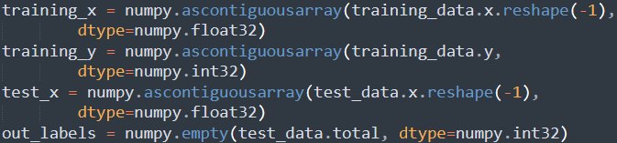
Basic Settings 基本设置 (2)
Initialize the host-side arrays
初始化主机端数组

Slide 16


OpenCL Runtime
OpenCL运行环境
Get the 1st device & create the queue
获取第一个设备并创建运行队列
Read the file ‘kernel.c’ & compile the kernel
读取’kernel.c’文件并对kernel进行编译

Slide 17
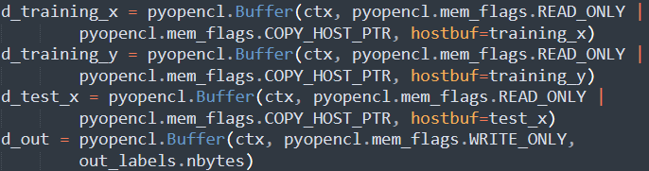
Host-to-Device Transfer
主机到设备的传输
Initialize device-side arrays &
copy data from the host to the device
初始化设备端数组，并将数据从主机复制到设备

Slide 18
Kernel Execution Kernel的执行
Configure the thread group size & the total thread number
设定线程分组大小及线程总数
The total thread number must be multiples of the thread group size
线程总数必须是分组大小的整数倍

Slide 19
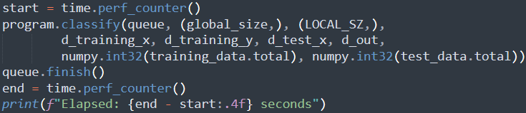
Kernel Execution Kernel的执行
Configure the thread group size & the total thread number
设定线程分组大小及线程总数
Time the kernel submission & execution
对kernel的提交和执行计时

Slide 20
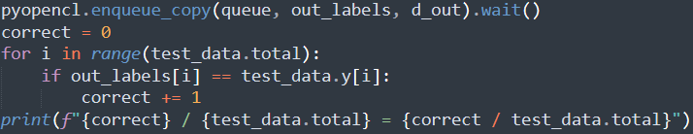
Output Results 输出结果
Copy the classification results back from the device
to the host & check the accuracy
将分类结果从设备复制回主机并检查准确率
Run it 运行之
python gpu.py

Slide 21
The End

